Slide 1


International Community Projects
Aldo Donetti
Program Manager
Cloud+AI International
aldod@microsoft.com
Twitter: @aldod

Slide 2
What & Why
Open Source (OSS) International Community Projects
The local developer Community helps to translate Open Source Software into their own language.
It’s a pure contribution for the non-English speakers in your Community.
International Community Contributions to docs.microsoft.com
The local developer Community can suggest improvements to the (now open sourced) documentation of most of our products.
It’s easy to do - it helps the whole developer Community.
It can help us improve our Machine Translation engines.
Help us spread the word
No Cons: no marketing stuff – only Community work
Just mention them during your next presentation and socialize it online
We can help you gain more visibility
Notes:
You will have noticed the emphasis on Community …

Slide 3
Open Source is a Community thing
The Community already contributes to the Software/code
Not everyone speaks English - OSS projects get translated so that everyone can benefit from them.
The Community contributes to the Translation (Crowd-sourcing model)
Translation is Enabled but it’s outside of the Source code Repo – it may not be obvioust to people how to contribute

Slide 4



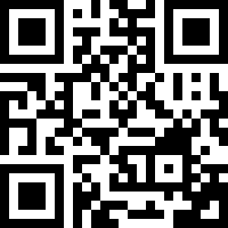
OSS Int.l Community Projects
SQL on Linux
SQL Ops Studio
Team Explorer
Everywhere
VS Code
And many more …
Check https://aka.ms/IntlDocsOSS
- how to join / contribute
- status updates

Slide 5
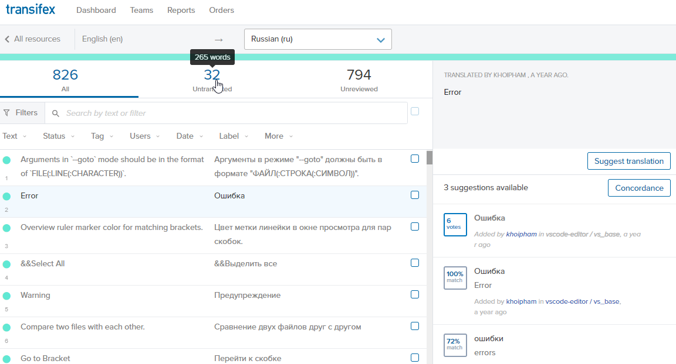
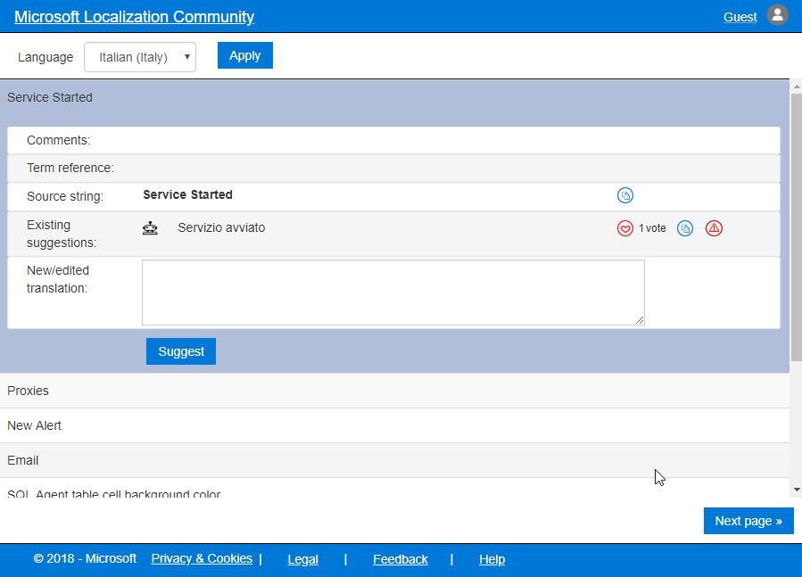
Tools
Transifex (VS Code) → | MLCP (all others)
https://www.transifex.com/ | https://aka.ms/MLCP ( https://envelope-community.azurewebsites.net )

Slide 6
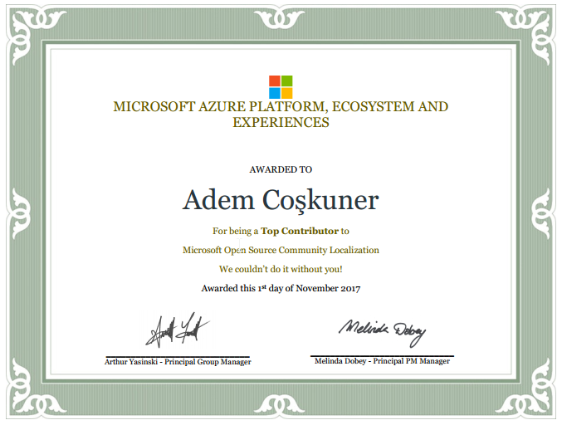







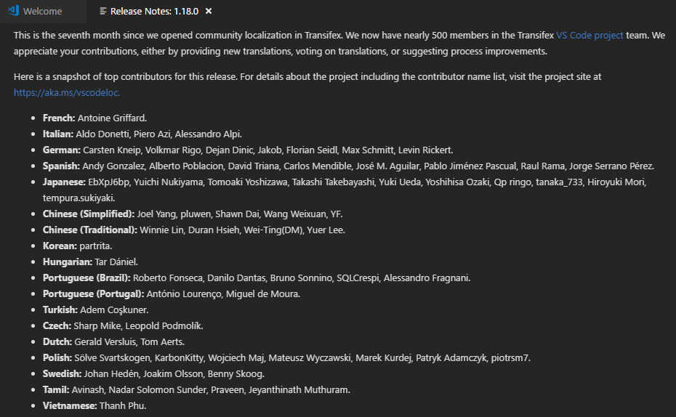
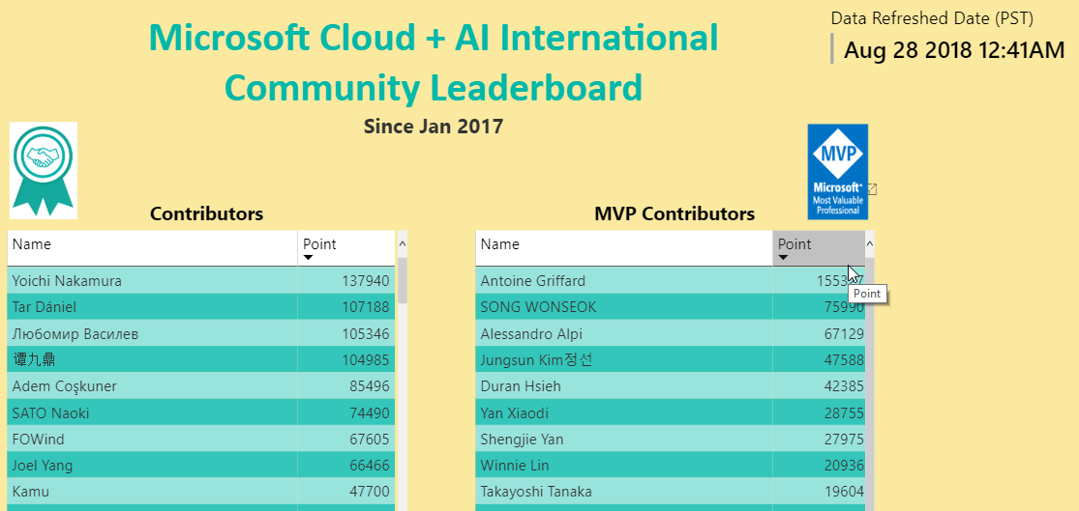
OSS Int.l Community – Status
1200+ members
Contributors are on the Leaderboard
https://microsoftl10n.github.io/
AND on the Products’ Release notes!
Certificates for top contributors
Calls with Engineering teams
Get updates
Twitter: @MicrosoftL10n
Social channels
http://aka.ms/IntlDocsOSS
17+ langs
22 requested
3+ Mil downloads
Notes:
https://marketplace.visualstudio.com/search?target=VSCode&category=Language%20Packs&sortBy=Downloads
#As of End of August 2018
Chinese (Simplified): 1,617,093
Japanese: 482,672
Spanish: 366,223
German: 339,434
French: 224,872
Russian: 202,728
Portuguese (Brazil): 181,286
Korean: 139,474
Chinese (Traditional): 117,343
Italian: 85,767
Turkish: 25,549
Hungarian: 8,512
Bulgarian: 1,749

Slide 7
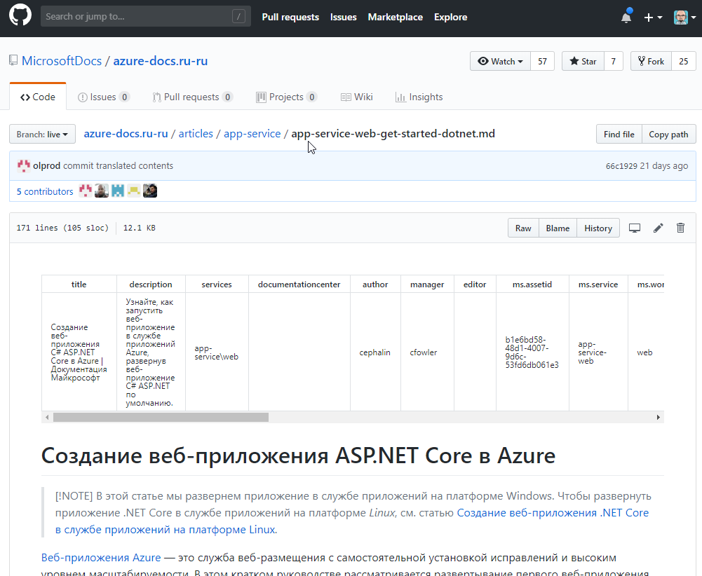
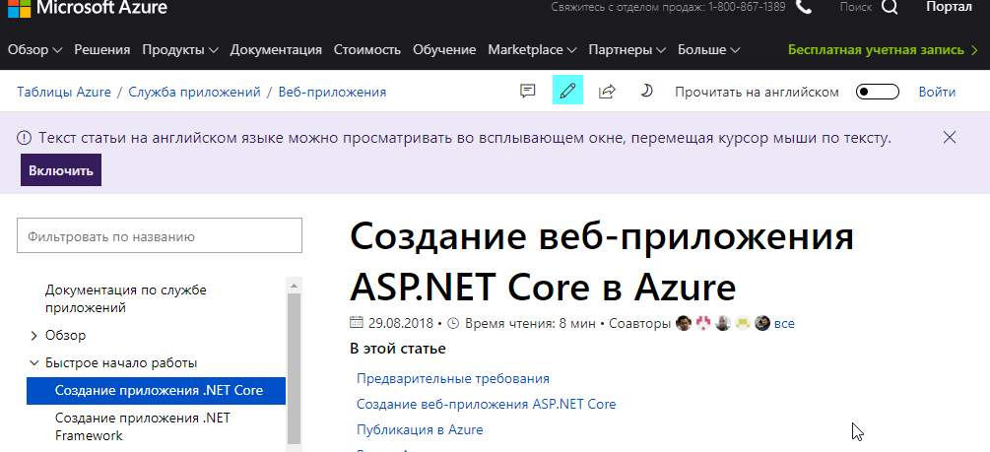
Docs can be a Community thing
docs.microsoft.com – new Technical content site
MSDN / TechNet → docs.microsoft.com (60% now)
Content hosted on GitHub
Designed to be edited by the Community
Microsoft does the translation
The Community can contribute to improve the overall quality of the content and of our Machine Learning/Machine Translation engines
Edits or whole articles
In English or in your own language
How? https://aka.ms/IntlDocs
p.s. – have you seen https://docs.microsoft.com/learn/ ?
Notes:
https://docs.microsoft.com/ru-ru/azure/app-service/app-service-web-get-started-dotnet
Now you have seen also the MSLearn initiative just launched at Ignite – for now no contributions are possible but it’s probably going to change

Slide 8
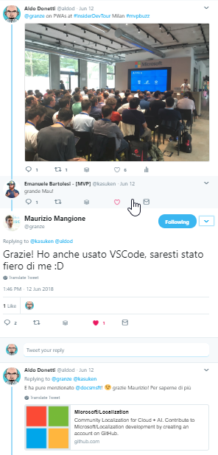
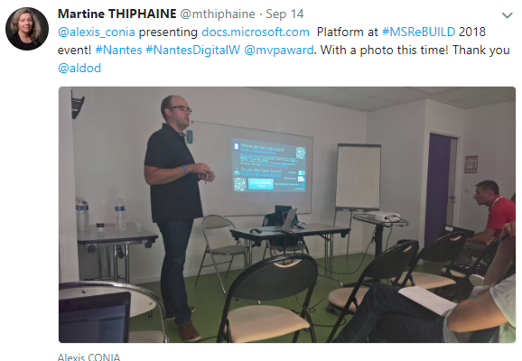
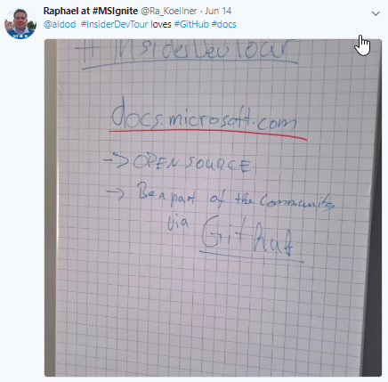
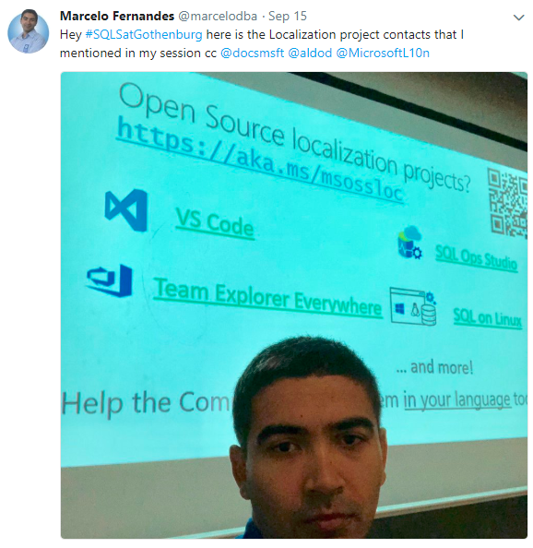
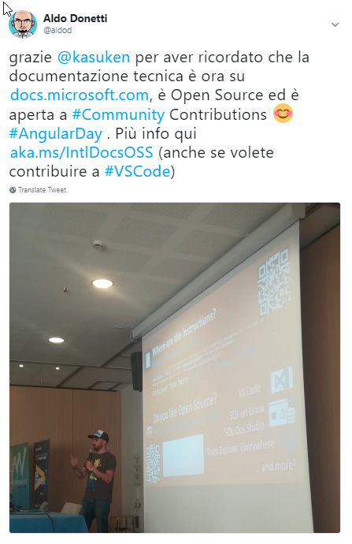
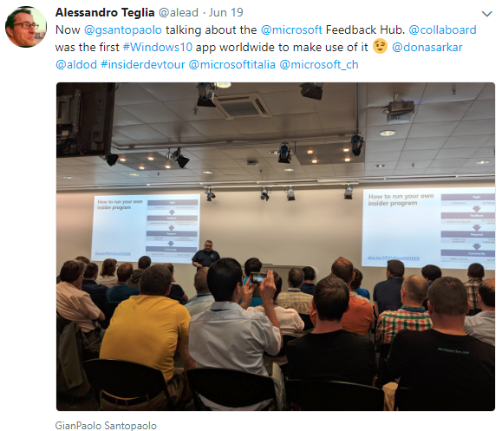
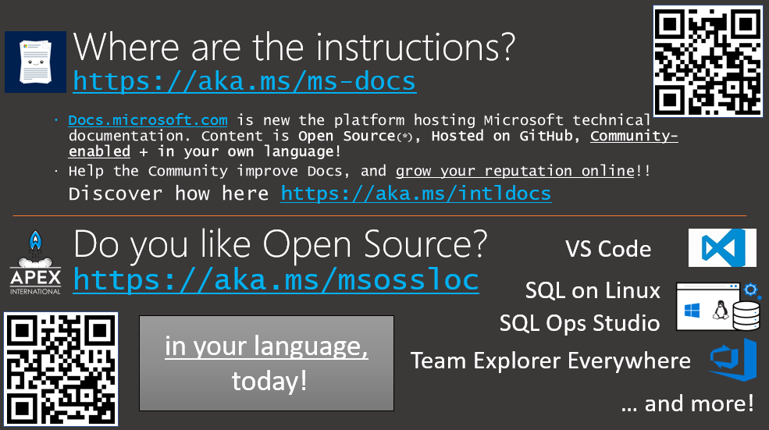
Please help us spread the word
Can you quickly mention it in your next presentation? (1 slide)
How other MVPs do it already:
Add the 1 slide to your deck and (plan to) mention it (<1 minute)
Before: Socialize your session (we can retweet -> help amplify)
During: Get a friend from the audience to take a picture of your talk
Not necessarily of that slide ☺
During/After: write a message with/without picture to Social channels
Twitter is preferred, but you can use other channels if we know beforehand
We can help retweet and promote your session and/or raise your visibility
Best if you /cc @aldod and/or your CPM and/or @MicrosoftL10n and @docsmsft
Tip: Local «tours» get even better visibility! (DotNetConf / Insiders Dev Tour)
https://www.dotnetconf.net/local-events/
But use the right hashtags!
Tip: Leverage Global efforts (like Hacktoberfest 2018) or propose your own (Hack-a-Doc)
NOTE: contributions count against MVP status
Notes:
Today we have a vendor that monitors all languages – tomorrow we may need trusted moderators

Slide 9

Questions?

Slide 10
Appendix

Slide 11
Supporting short Slide decks
1 slide
2 slides (1 for Docs / 1 for OSS)

Slide 12
1 slide

Slide 13
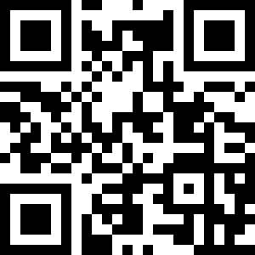

Where are the instructions? https://aka.ms/ms-docs
Docs.microsoft.com is new the platform hosting Microsoft technical documentation. Content is Open Source(*), Hosted on GitHub, Community-enabled + in your own language!
Help the Community improve Docs, and grow your reputation online!!
Discover how here https://aka.ms/intldocs
Do you like Open Source? https://aka.ms/msossloc
VS Code
SQL on Linux
SQL Ops Studio
in your language,
today!
Team Explorer Everywhere
… and more!

Slide 14
2 slides
1 for Docs
1 for OSS projects
Can be customized as you like

Slide 15
Where are the instructions? https://aka.ms/ms-docs
docs.microsoft.com is new the platform hosting Microsoft technical documentation
Content is Open Source(*), Hosted on GitHub, Community-enabled + in your own language!
So YOU can help the community of users Worldwide to get a better experience by improving the Docs, and grow your reputation online!!
Discover how here https://aka.ms/intldocs
Notes:
Core documentation includes: Reference material (w/interactive examples), Overview material, Quick Starts, Tutorials, Samples, How-Tos.
Soon: Cross-Product Tutorials / Hands-on-Labs / Deployments to Azure

Slide 16
Do you like Open Source? https://aka.ms/msossloc
VS Code
SQL on Linux
Team Explorer Everywhere
… and more!
Help the Community to get them in your language today!

Slide 17
About Docs

Slide 18
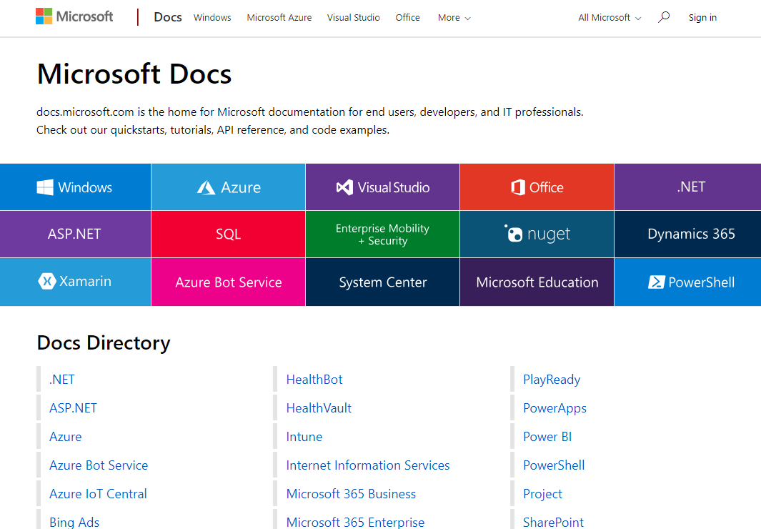
Docs - the «New Hope» for Technical Content
https://docs.microsoft.com
Key Principles:
Great Content
Modern/fresh UI
Standard Formats & Tools
Agile publishing
Community-enabled
Global by default

Slide 19
Docs – in detail
Content:
Re-engineered
More Samples
Quickstarts & Tutorials
stored in GitHub / Markdown format
Backend:
Runs on Azure
Highly automated single-article publishing
also uses BOTs for process management
Frontend:
Completely redesigned / Responsive UI
Feature-rich
New & Contextual Search
API Browser w/ versioning
Integrated CLI
Community-enabled (Editing/Feedback)
Global by Design
in 67 Languages
Hover-over (MT) / Read in English

Slide 20
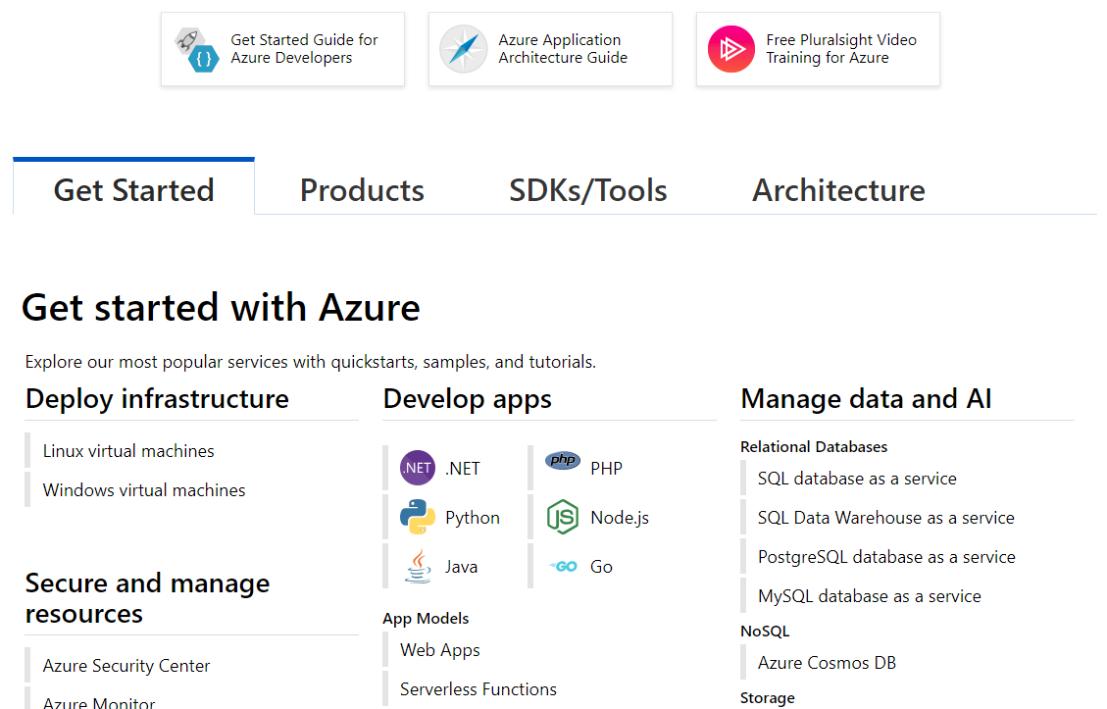
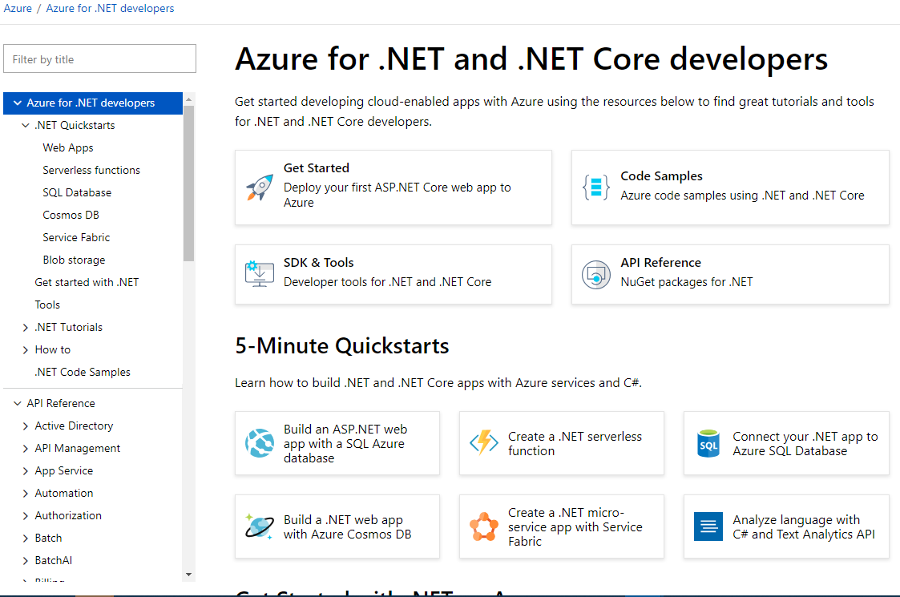
Redesigned site …

Slide 21
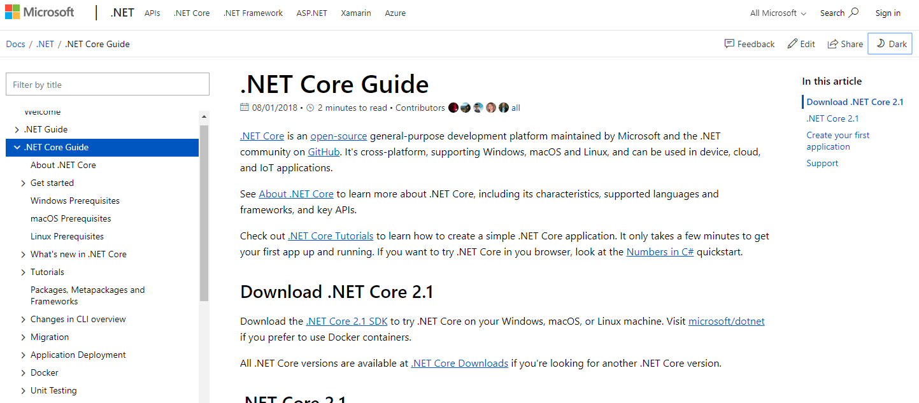
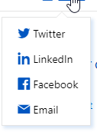
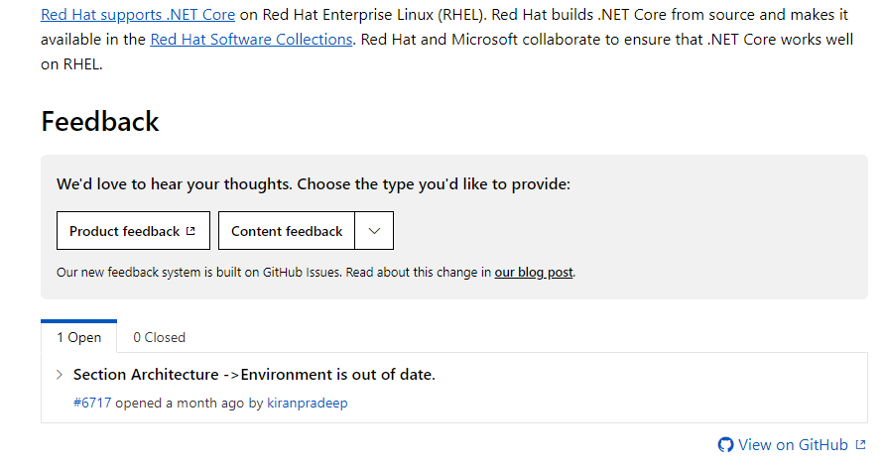
… and content

Slide 22
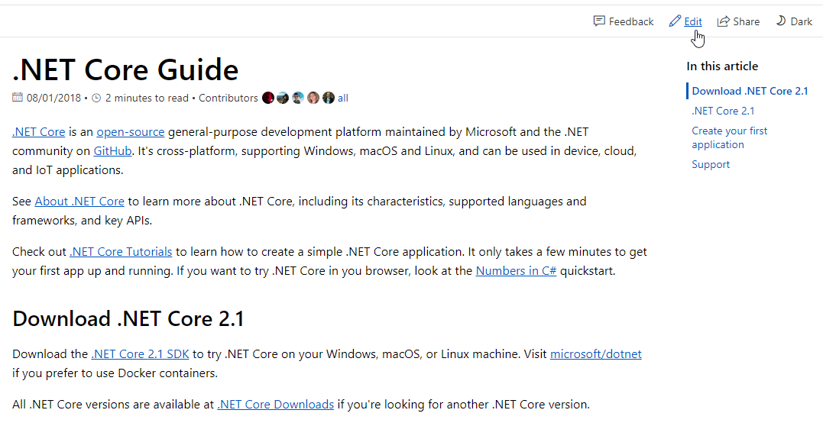
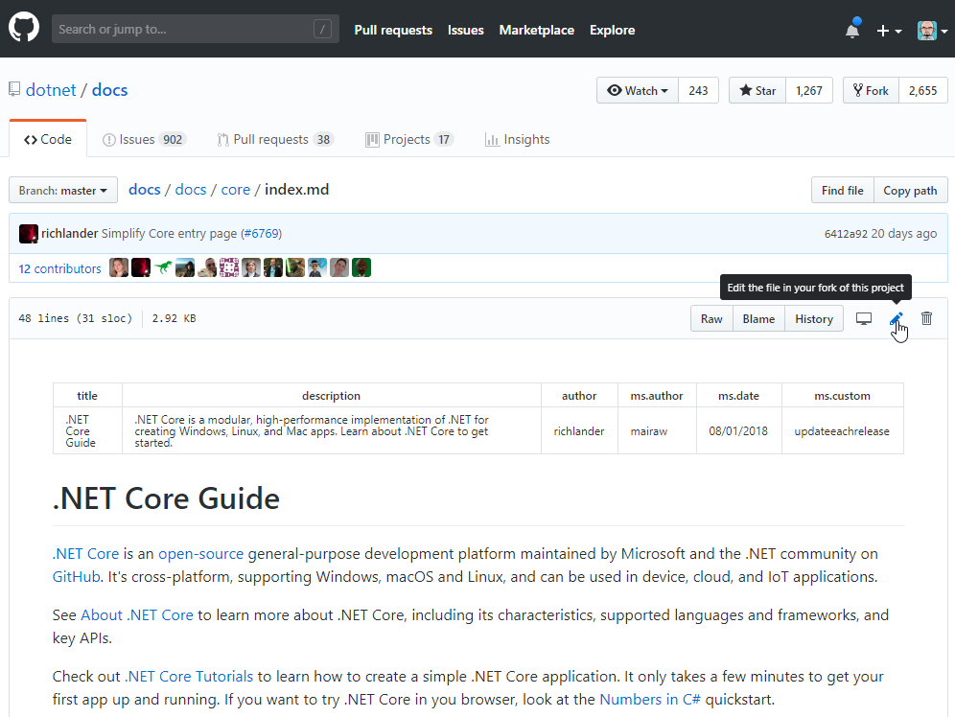
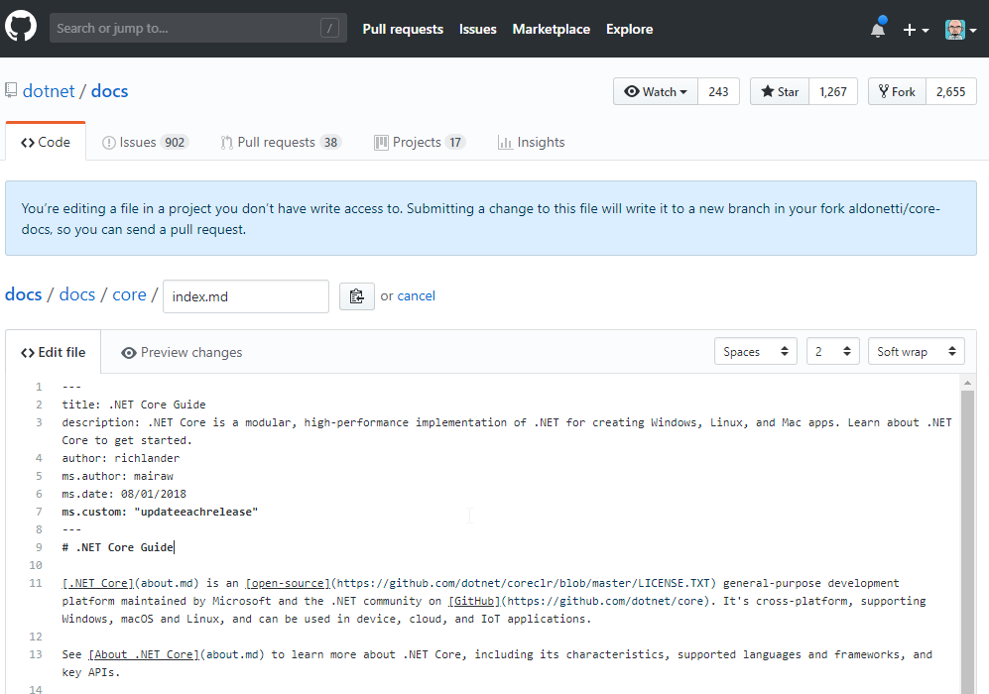
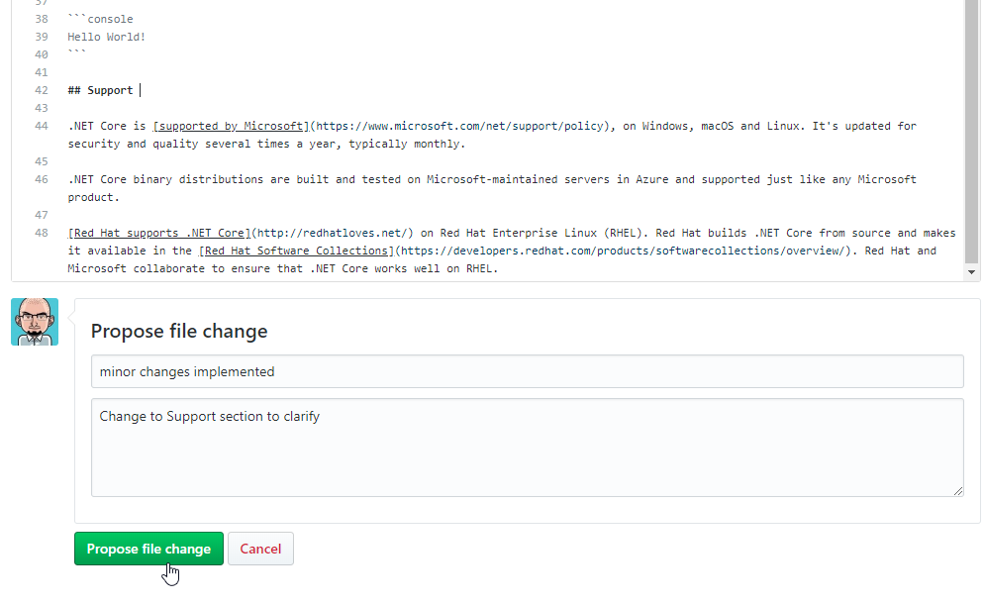
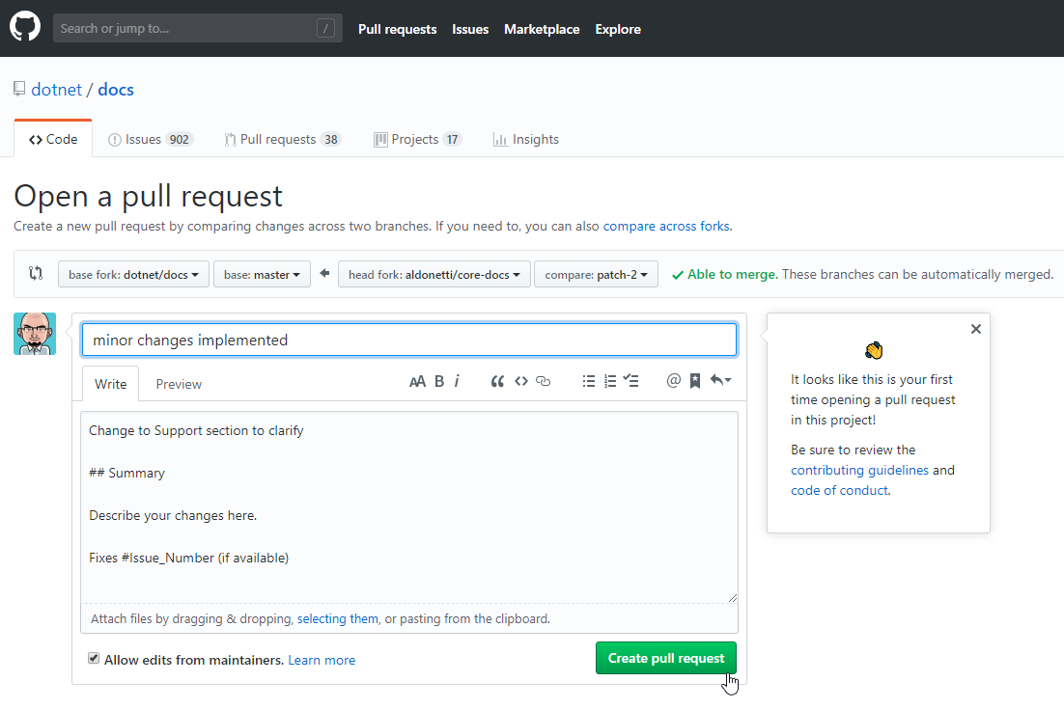
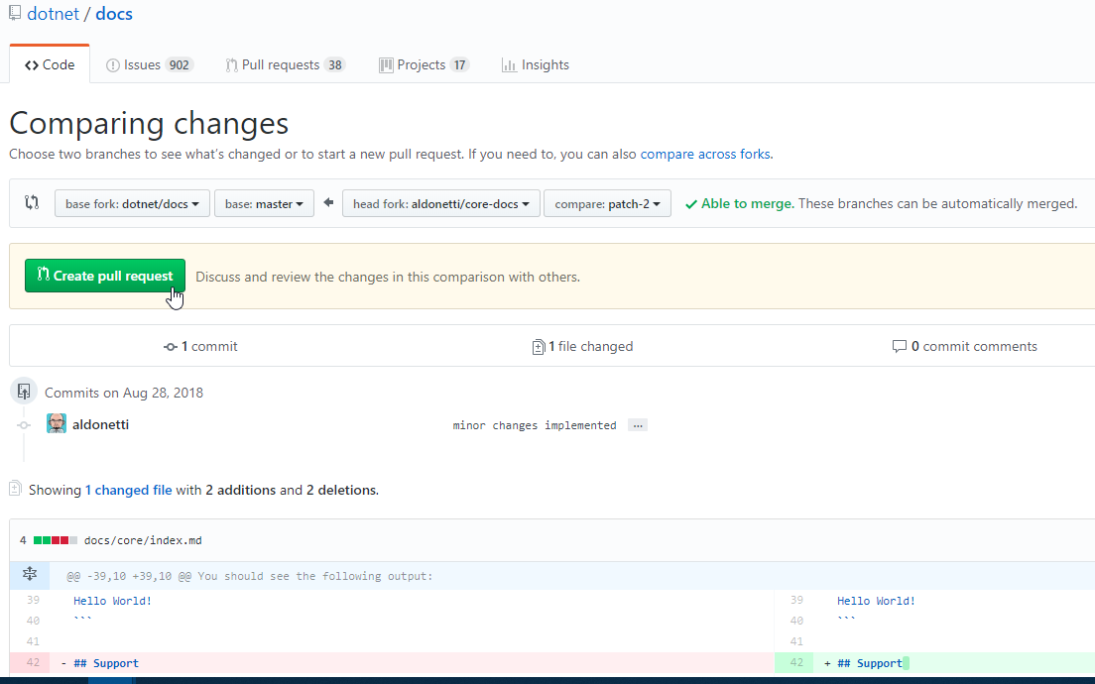
Contribution/Editing experience
Notes:
https://docs.microsoft.com/en-us/dotnet/core/

Slide 23
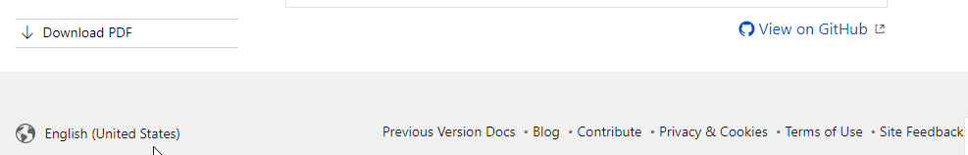
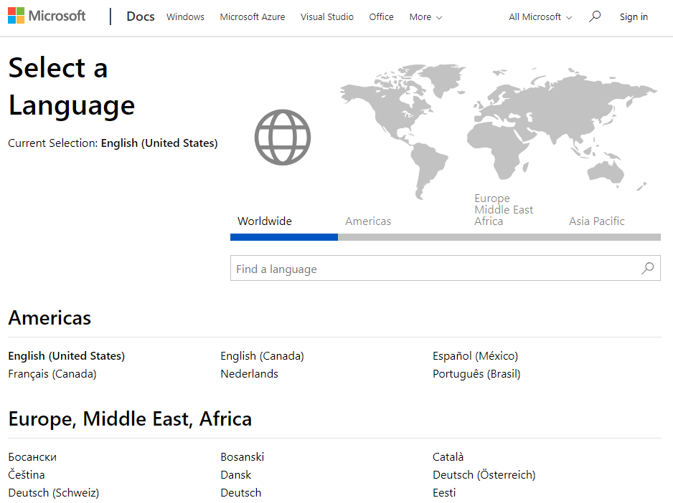
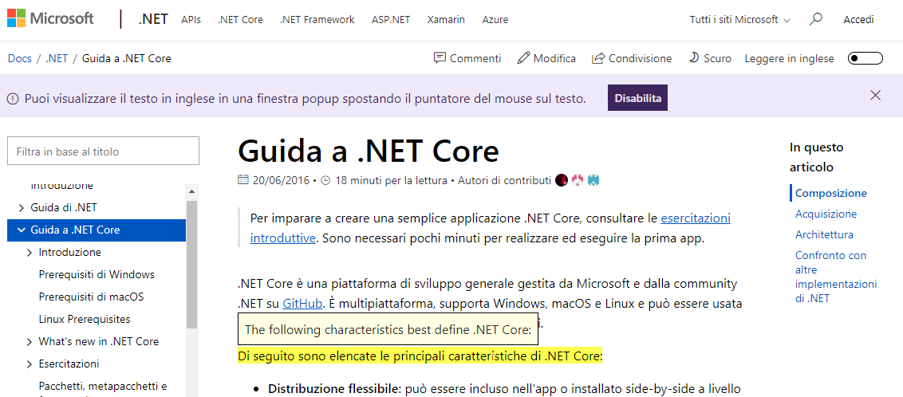
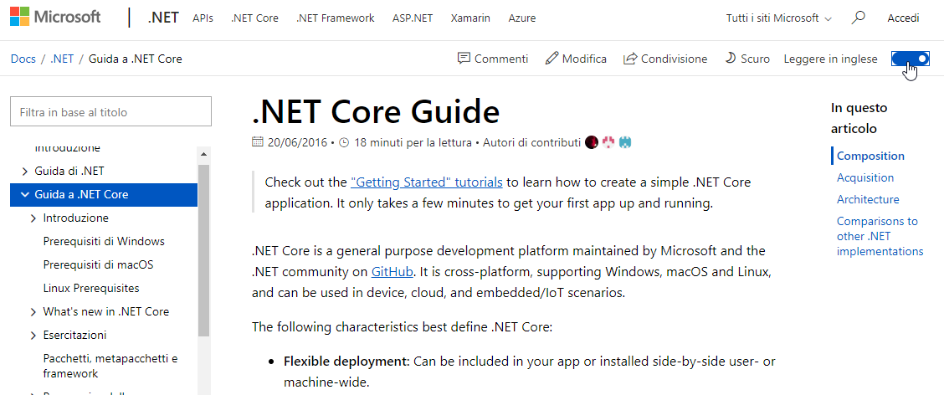
Global by default
Notes:
67 languages if we include Dynamics’ docs

Slide 24
About Docs – more features
API browser
Integrated CLI

Slide 25
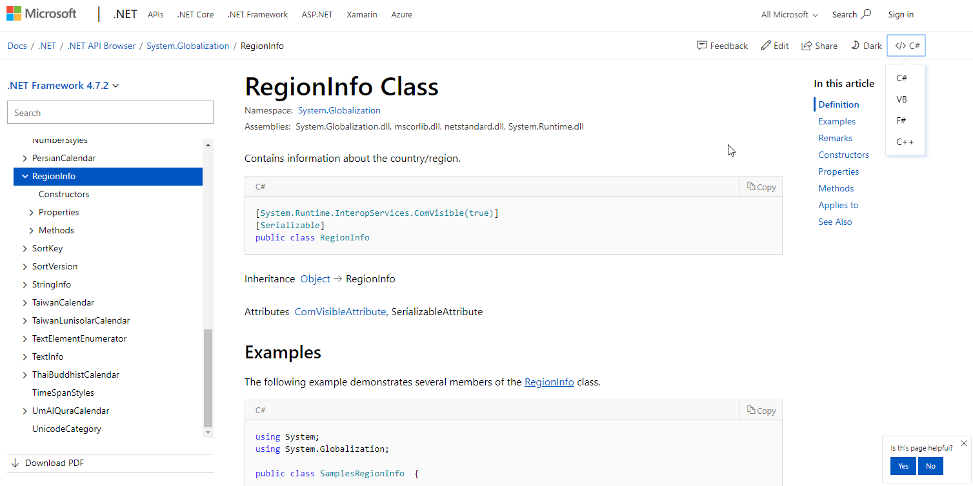
API Browser

Slide 26
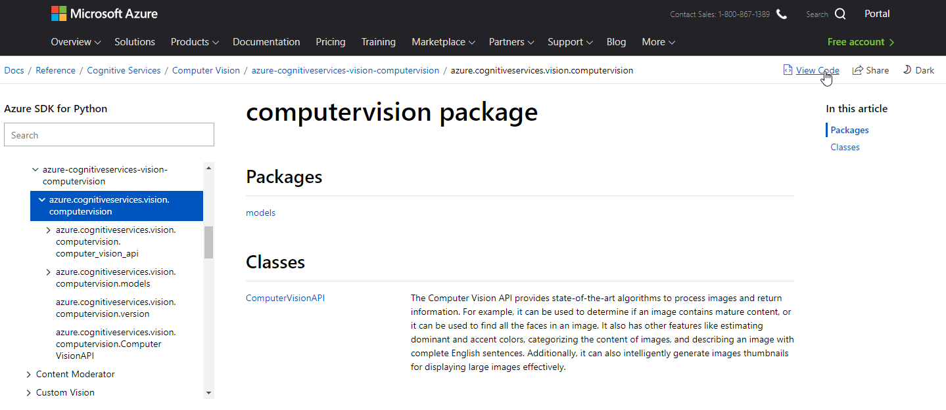
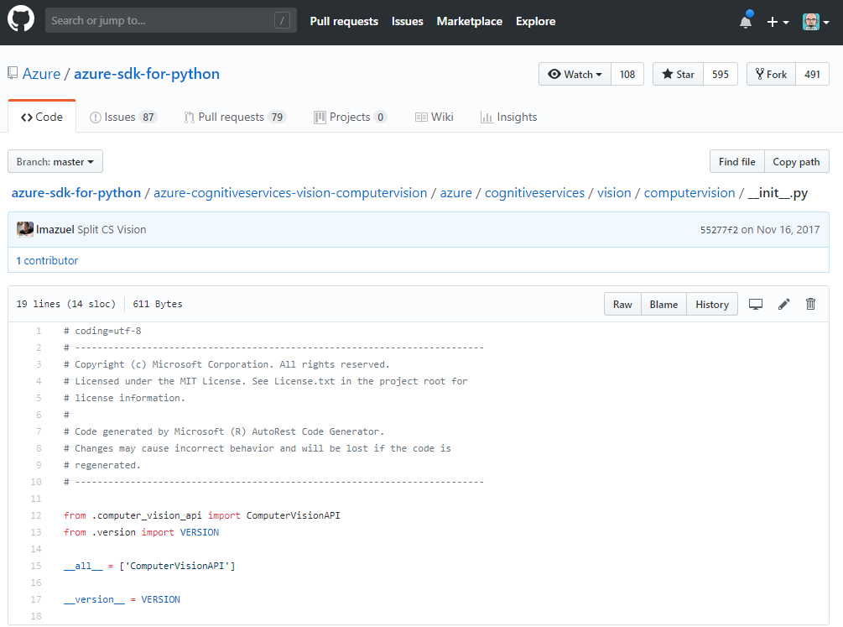
API Browser (cont.d)
Notes:
https://docs.microsoft.com/en-us/python/api/azure-cognitiveservices-vision-computervision/azure.cognitiveservices.vision.computervision?view=azure-python

Slide 27
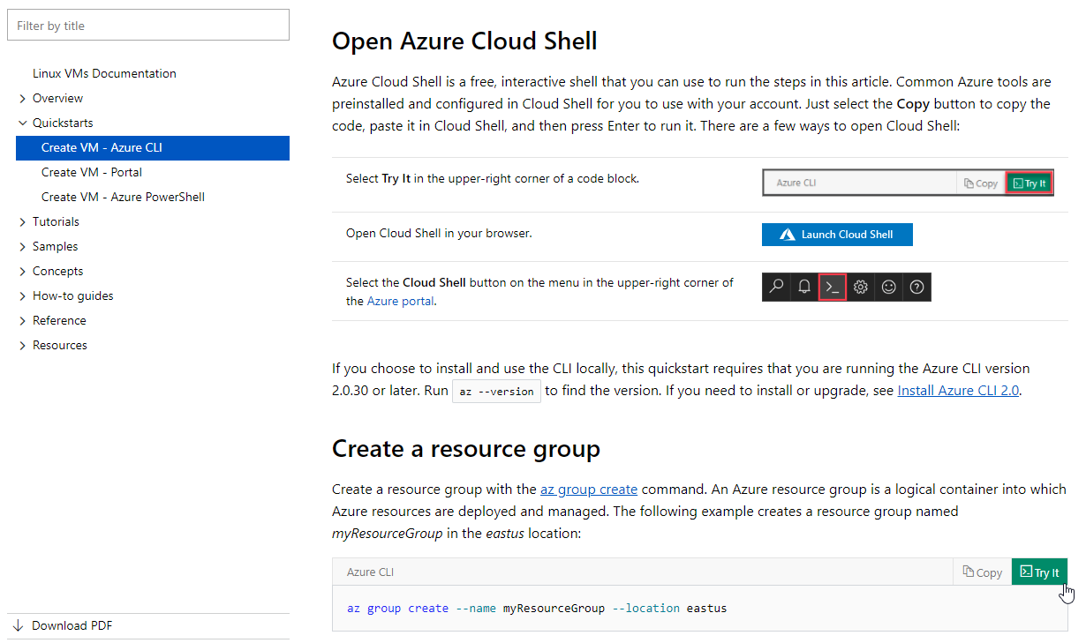
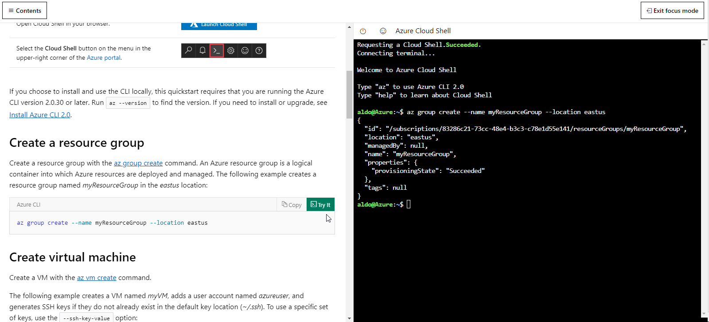
Integrated Cloud Shell

